Slide 1
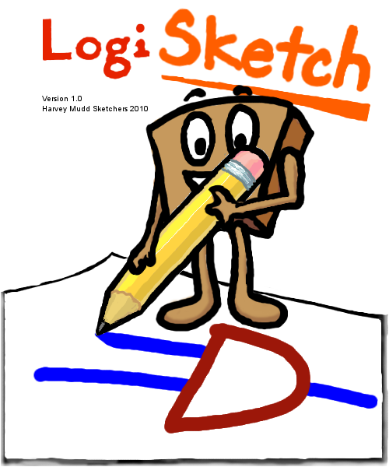
LogiSketch User Interface
Alexa Keizur, Kiley Sobel, Andy Kearney, Fiona Foo
Notes:
Kiley

Slide 2
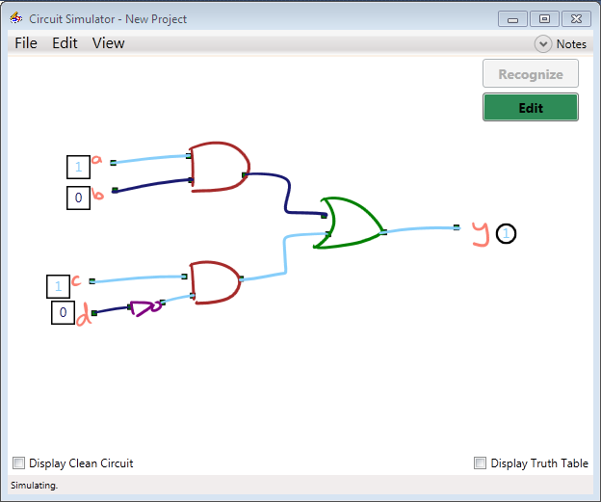

Overview
Draw, recognize, and simulate logic circuits
Pen-based system
Fun to use
Notes:
Kiley
LogiSketch is a pen-based program where users can draw and simulate logic circuits. Sketching the circuits is more natural than using other WIMP based programs like LogiSim, and we’re hoping it becomes a program that is easier, less frustrating, and therefore more fun to use as well. Basically, to use the program, you draw your desired logic circuit; the program then uses sketch recognition to classify the components of your drawing. After the circuit is perfectly recognized, you can simulate your circuit with different inputs manually or use the truth table to toggle different inputs and see the results.

Slide 3
Major Issues
Unclear recognition feedback mechanisms
Some recognition errors without indication
System learnability
Impact of incorrect recognition
Notes:
Andy

Slide 4
New Features
Add more (clearer) recognition feedback mechanisms
Better help system
Error correction mechanisms
Improve general usability
Notes:
Feedback: display all labels at once, differentiate inputs/outputs,
Help system: color key for circuits components, “beginner” mode with lots of hints
Error correction: grouping v. labeling, snapping endpoints, modify re-labeling, etc
General usability: move buttons, add gestures, change menu system
User test for great justice!
Fiona

Slide 5
User Study
How can users and recognizers adapt to each other?
What feedback mechanisms can help users change their drawing style?
Notes:
Alexa

Slide 6
Questions?

